Slide 1
Team 1
Aishwarya S., Alfredo F., Elias S., Isha P., Zeeshan A.

Slide 2


Slide 3

Project Scope and Objectives
Creating a cards game
SAAS application
Play, draw, discard, and trade cards
Shared room
Third party authentication
Security
https://theplayingcardfactory.com/

Slide 4
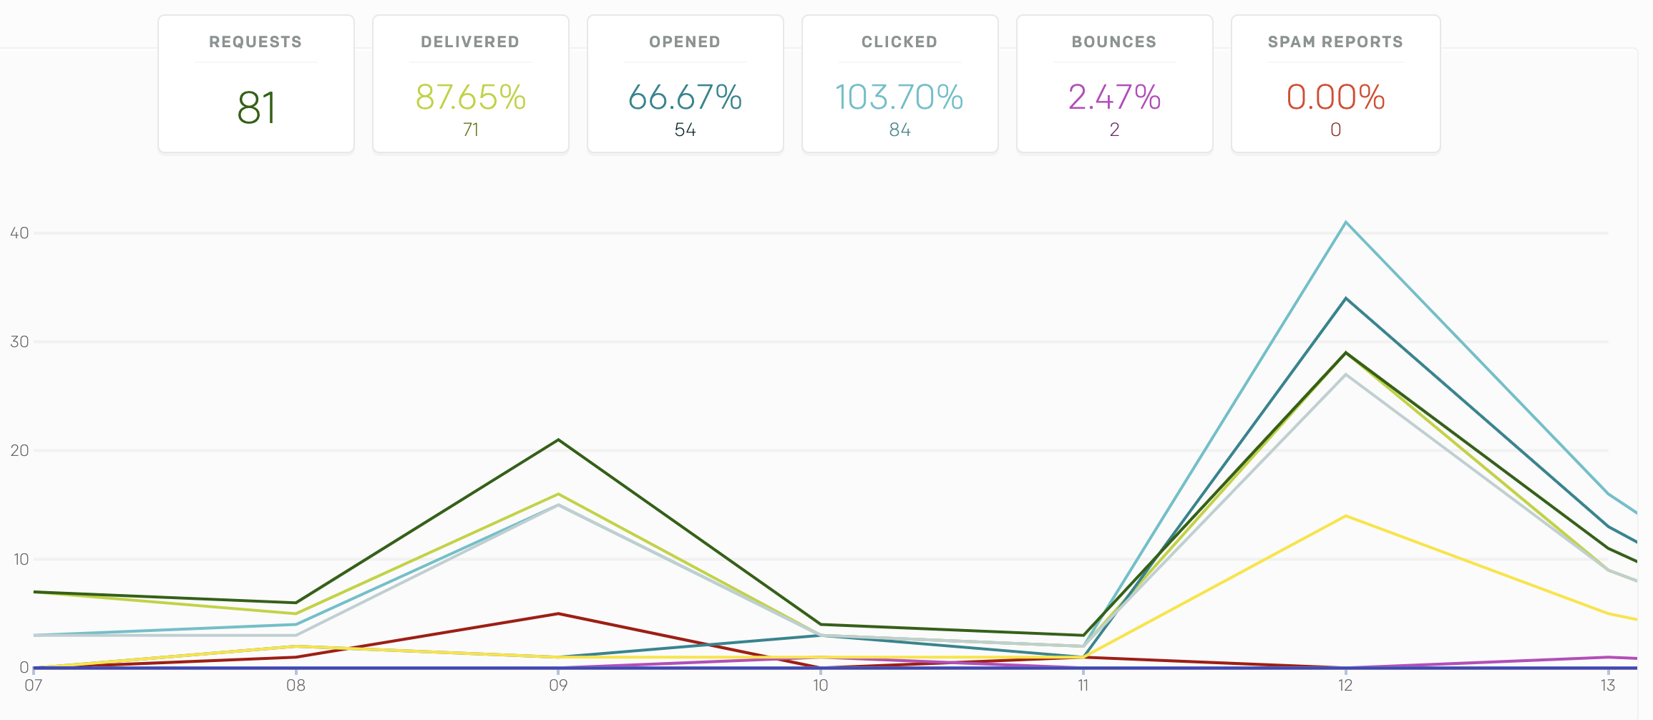



Features
Devise
Pusher
SendGrid
Omniauth
Bootstrap
Secure Login
Notes:
Zeeshan

Slide 5
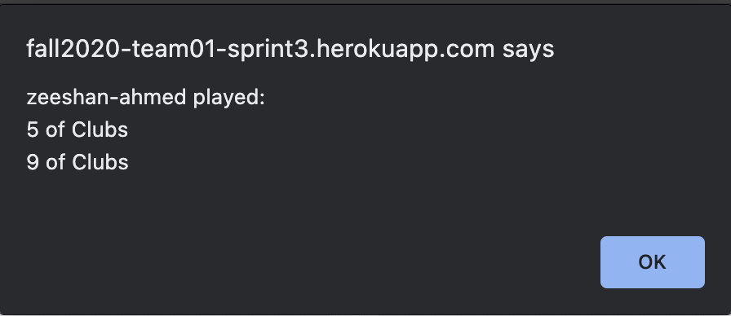
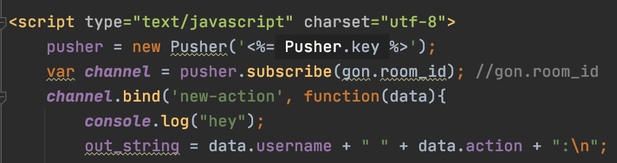

Features
Notifications pushed to all the players
Auto refresh the page

Slide 6
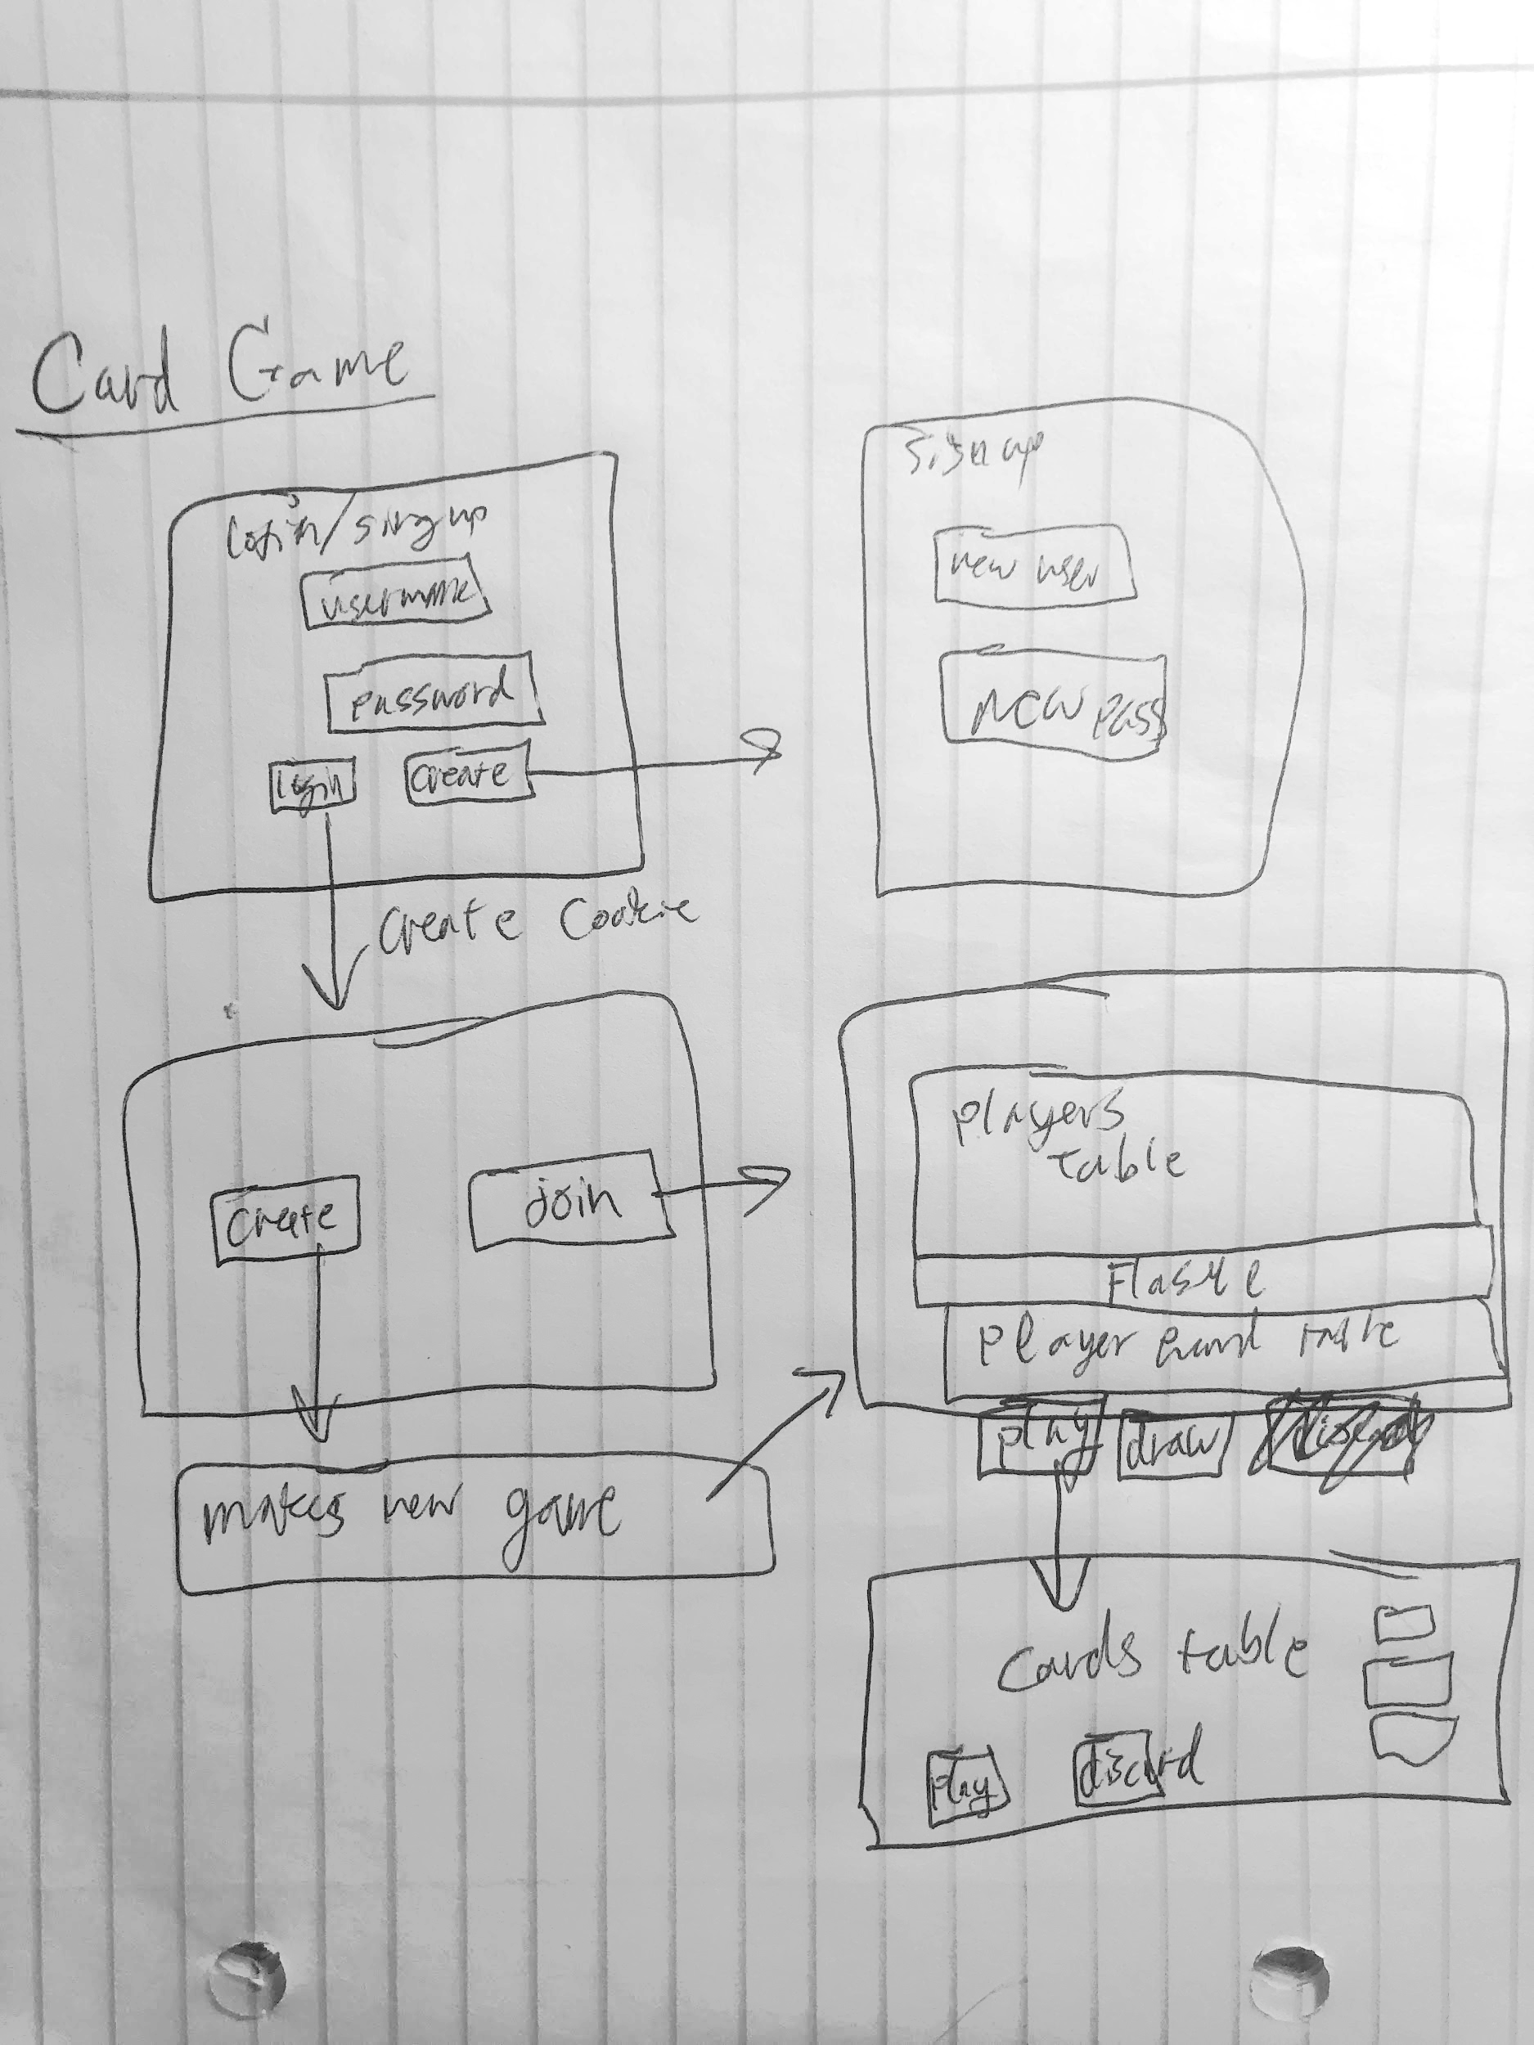
Behavior Driven Design (BDD)
User stories
Acceptance Test
Capybara
Given, When Then

Slide 7
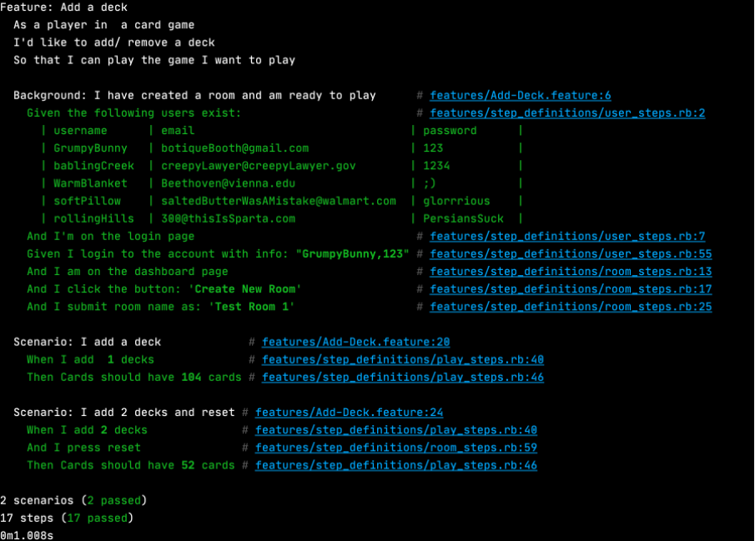

Slide 8
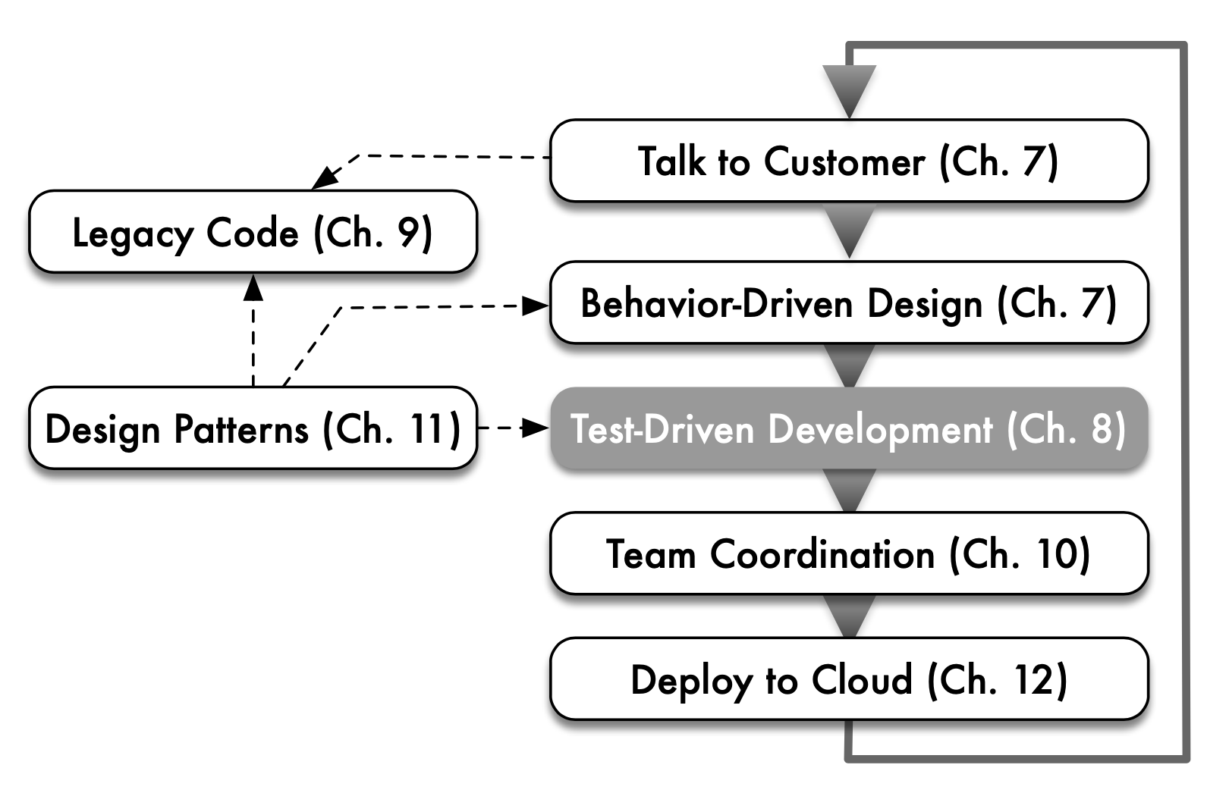
Test driven Development (TDD)
Rspec gem
Describe
It ‘should’ do
Red green refactor
Factory Bot
Macros
David P., Armano F. (2020). Engineering Sofware as a Service: An Agile Approach Using Cloud Computing (2nd ed.). (238)

Slide 9
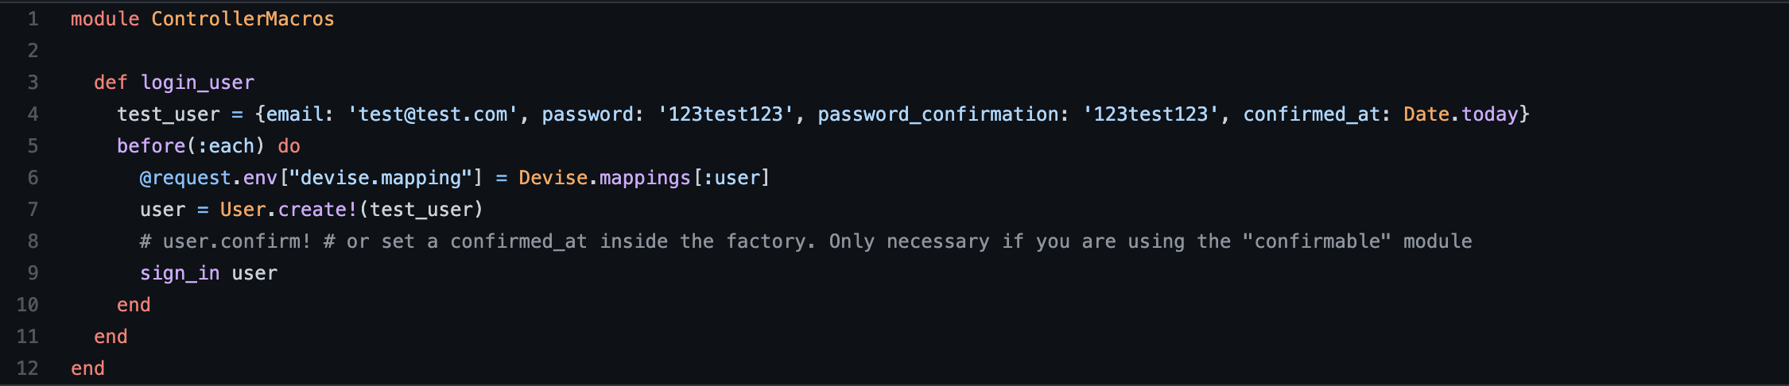
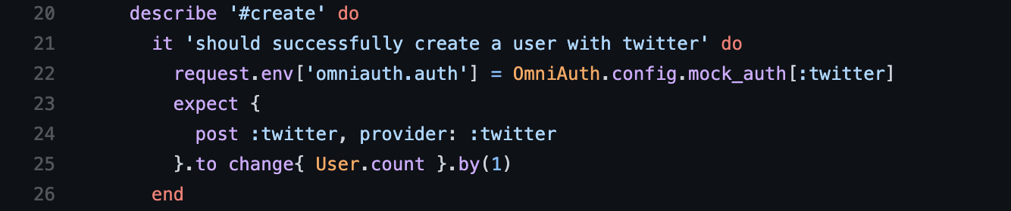
Examples

Slide 10
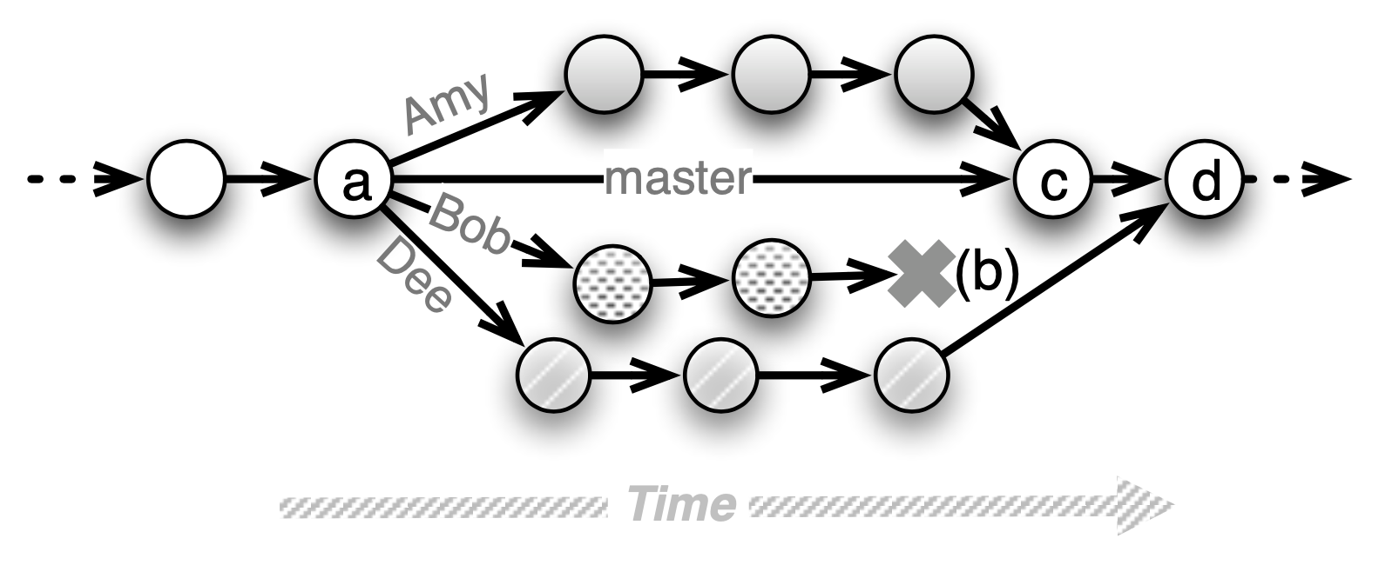

Version Control
Pull requests
Wiki page
Branches
Commit messages
Issues
Continuous Integration
https://justwriteclick.com/2015/12/17/why-use-github-as-a-content-management-system/
David P., Armano F. (2020). Engineering Sofware as a Service: An Agile Approach Using Cloud Computing (2nd ed.). (238)
git commit -m “made changes”

Slide 11
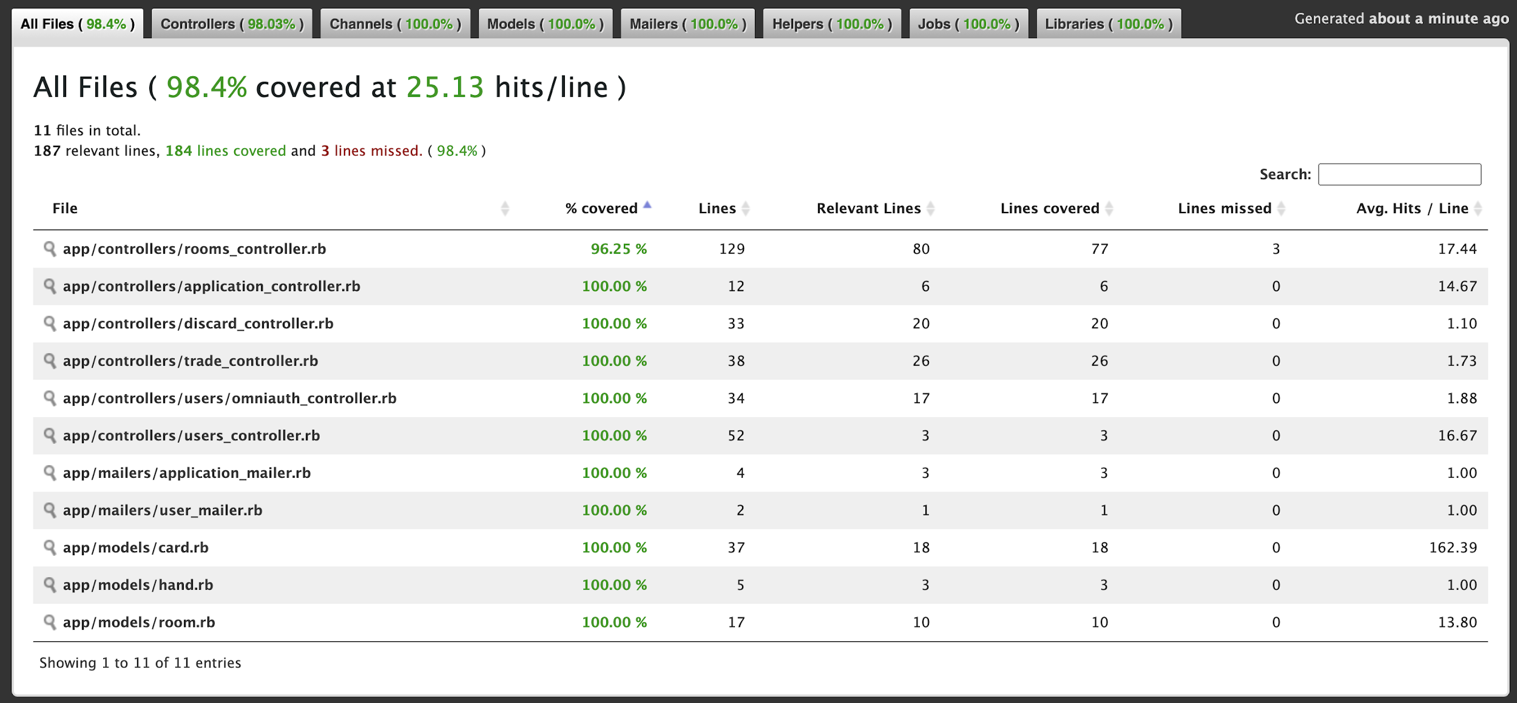

Slide 12
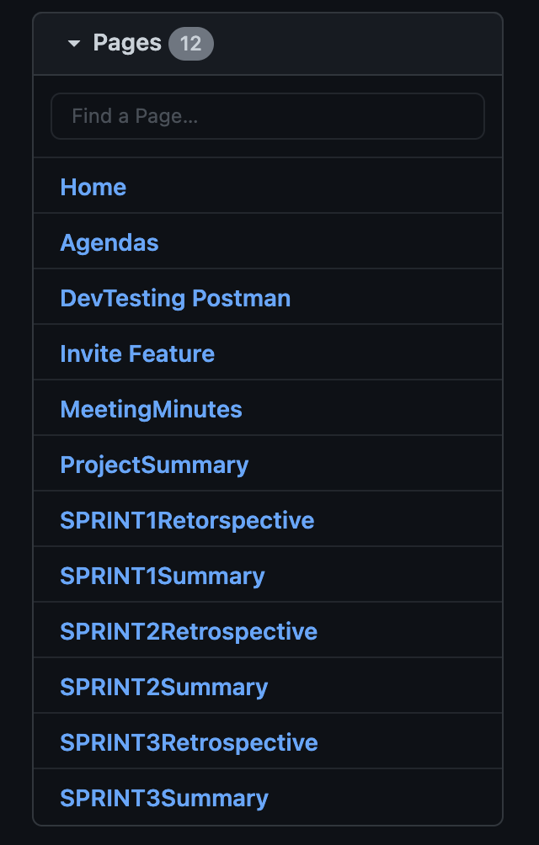
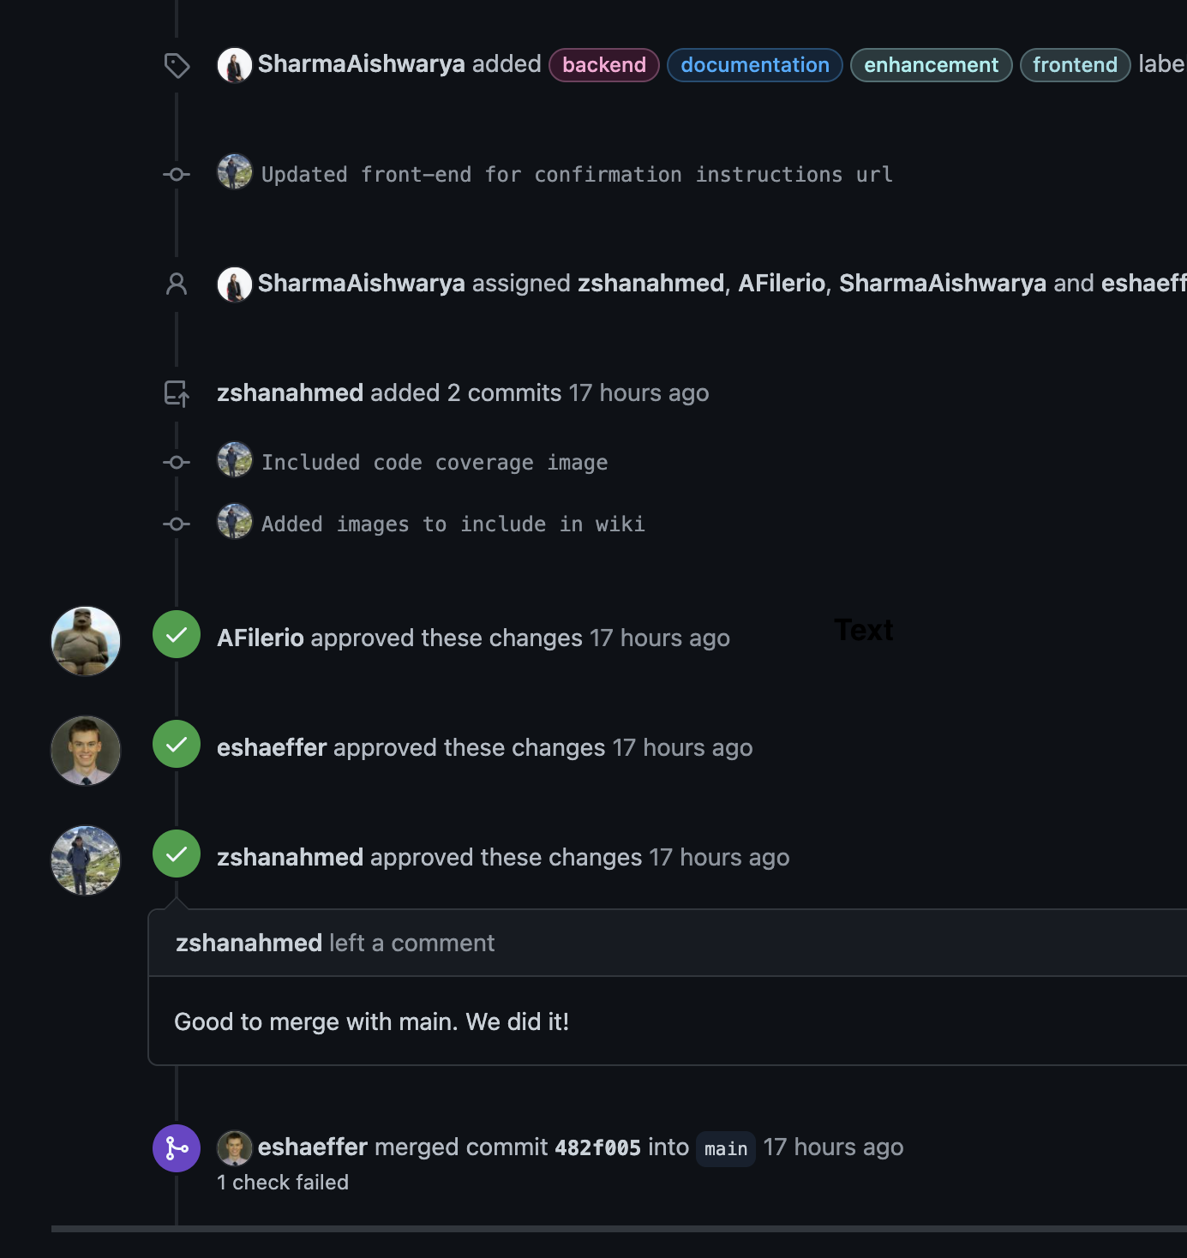
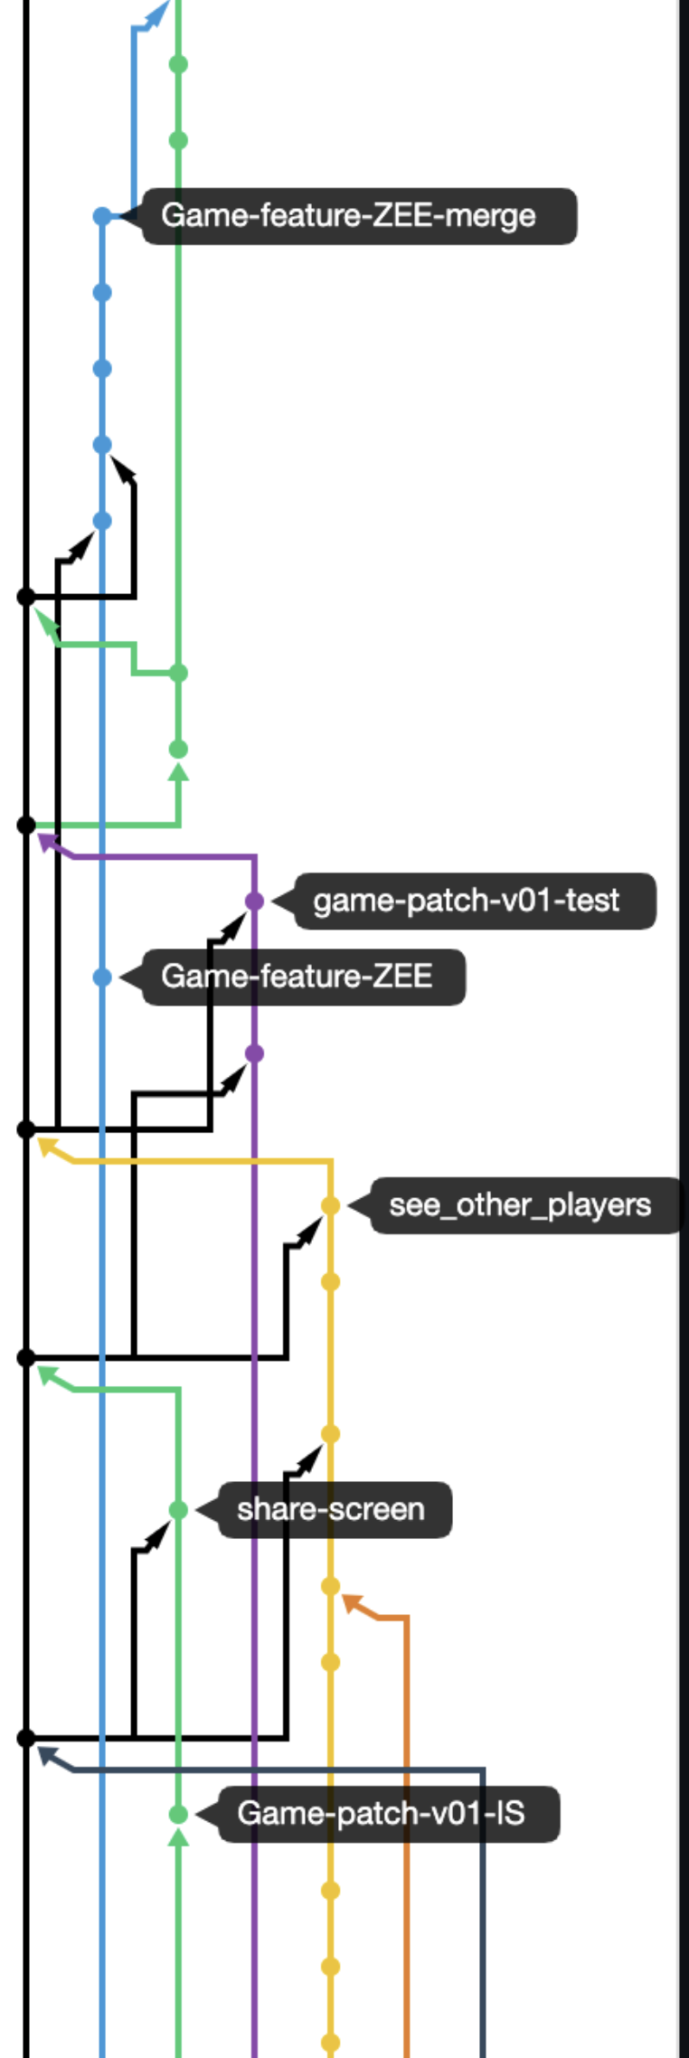
Example

Slide 13
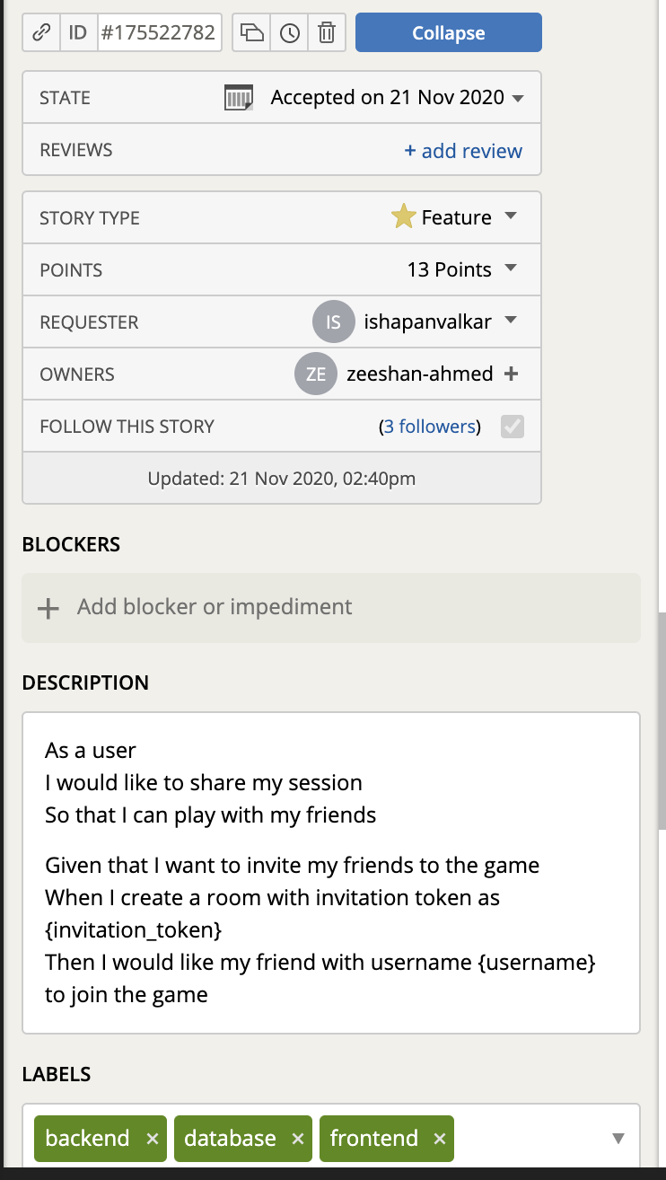
Pivotal Tracker
User Stories
Acceptance Criteria
Labels
Points given to the story
Swim lanes i.e current iteration, icebox, done, Epics
Owners, Requester
Tasks
Blockers
Velocity

Slide 14
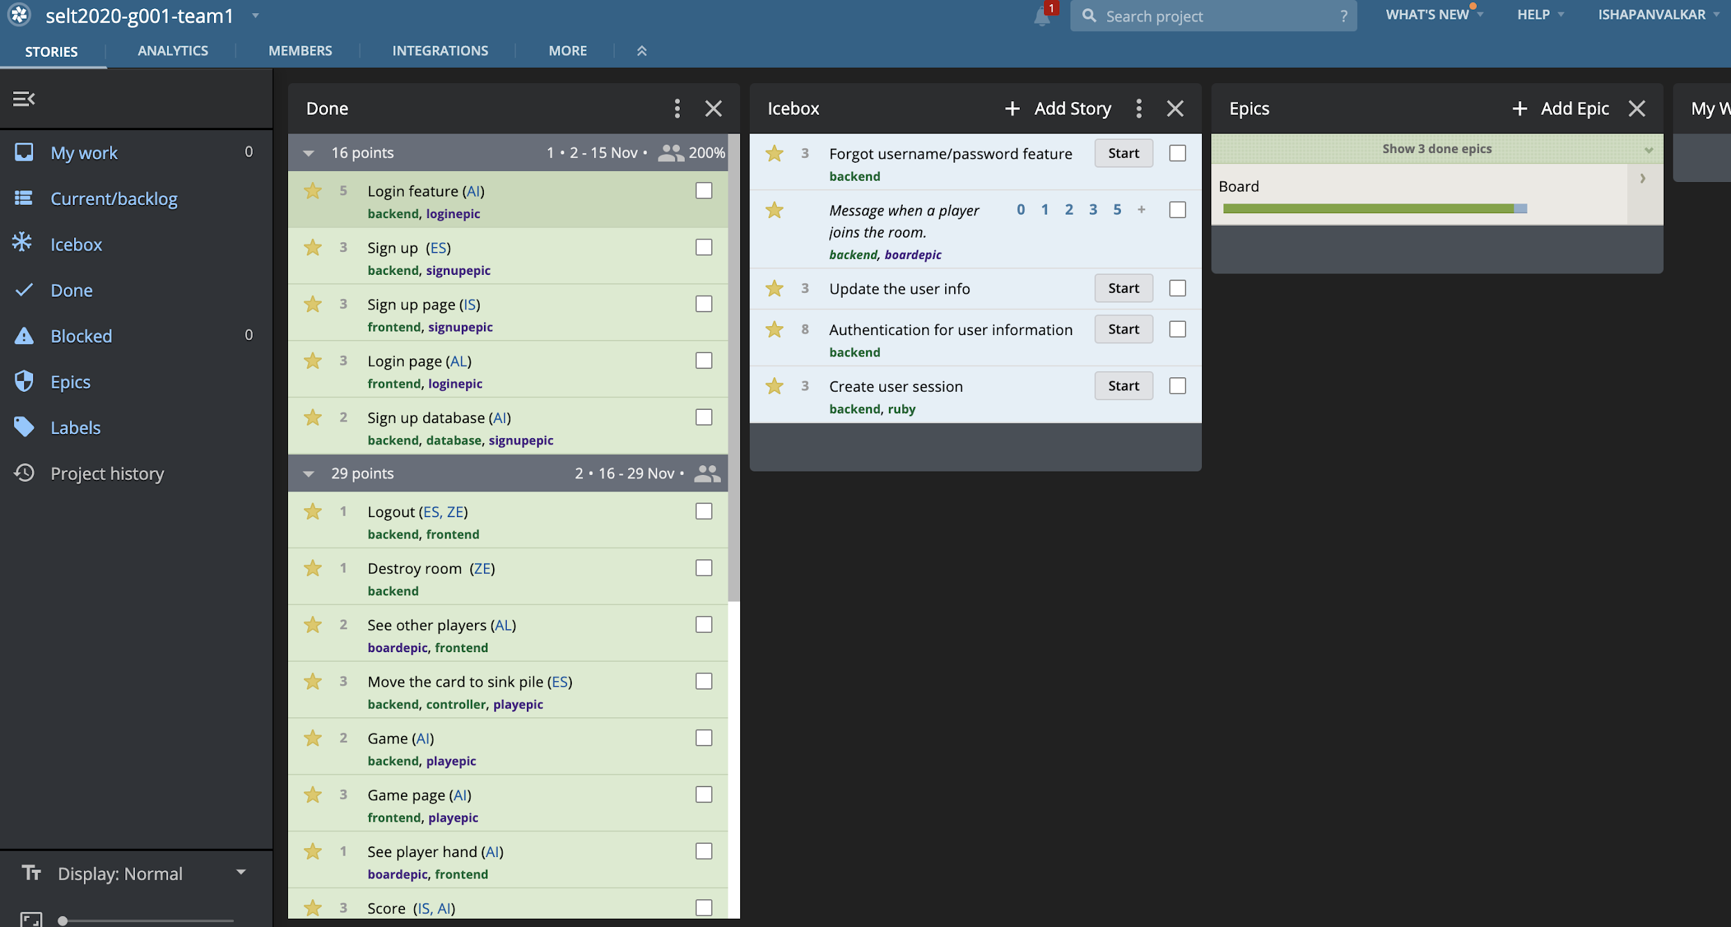

Slide 15
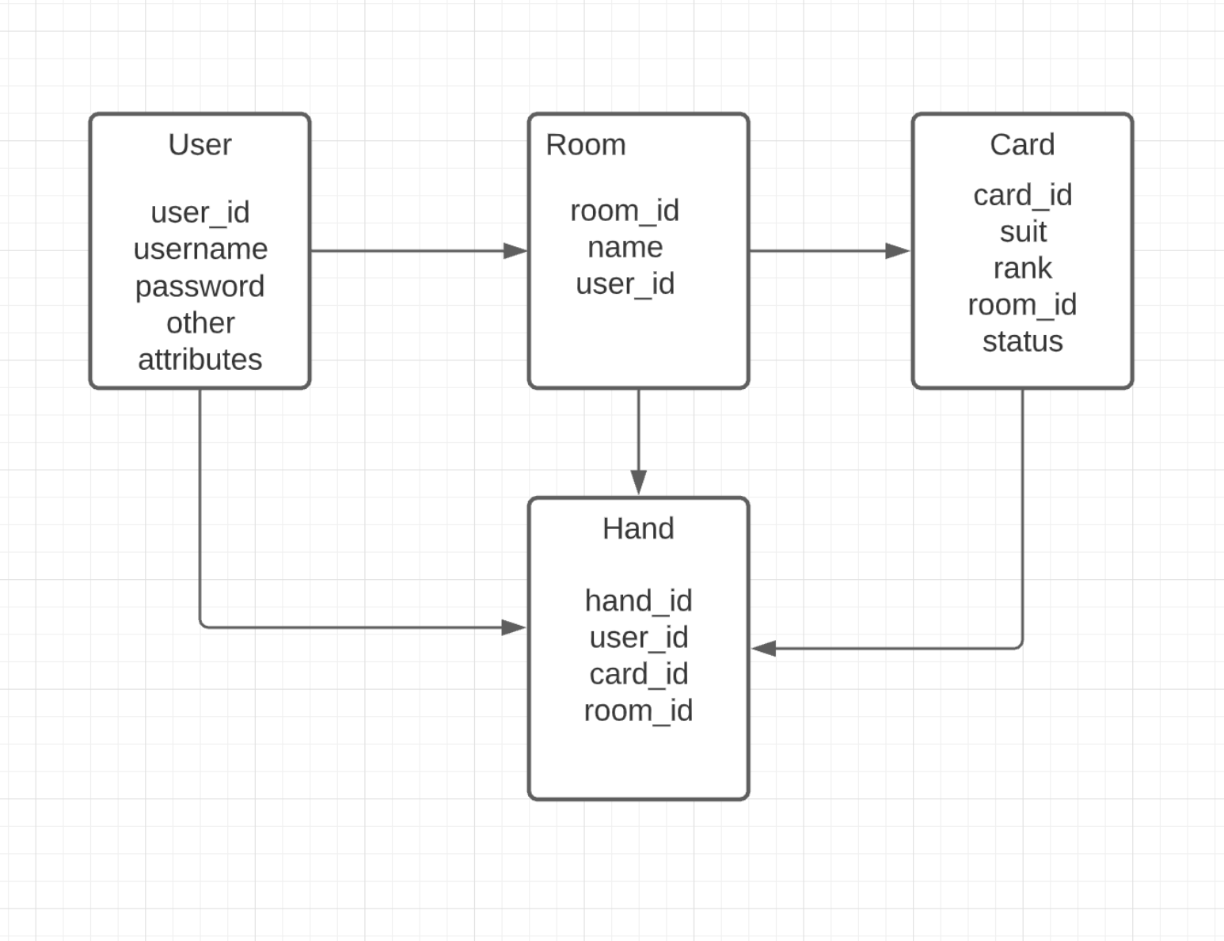
Database
For each user we have a room and a hand.
Each room further will have Cards and Decks associated with it.
These cards will also be associated with hand.

Slide 16
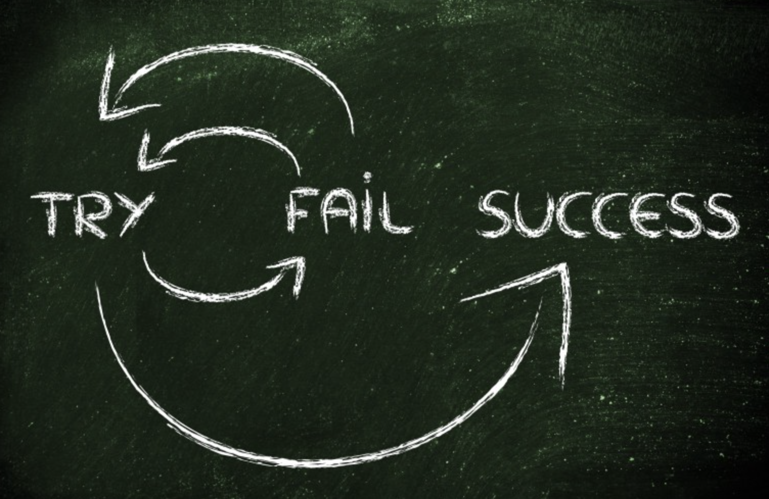
Lessons Learned
What went well
Pair programming
Avoided merge conflicts
Testing
Pivotal Tracker
What went wrong
Lack of communication
Testing with devise
Configuring sendgrid
https://medium.com/re-write/retrospective-top-lessons-learned-during-first-semester-at-bdw-57a5d79f38f7

Slide 17
Works Cited
David P., Armano F. (2020). Engineering Sofware as a Service: An Agile Approach Using Cloud Computing (2nd ed.). (238)
https://justwriteclick.com/2015/12/17/why-use-github-as-a-content-management-system/
https://www.thoughtco.com/standard-deck-of-cards-3126599
https://www.stackoverflow.com
https://medium.com/re-write/retrospective-top-lessons-learned-during-first-semester-at-bdw-57a5d79f38f7

Slide 18
Thankyou
Questions ?

